Slide 1
"Preparation for Life and Eat for Chinese Students in Northeastern University"
许恒嘉 谢宇豪
AP Statastic
Section6

Slide 2
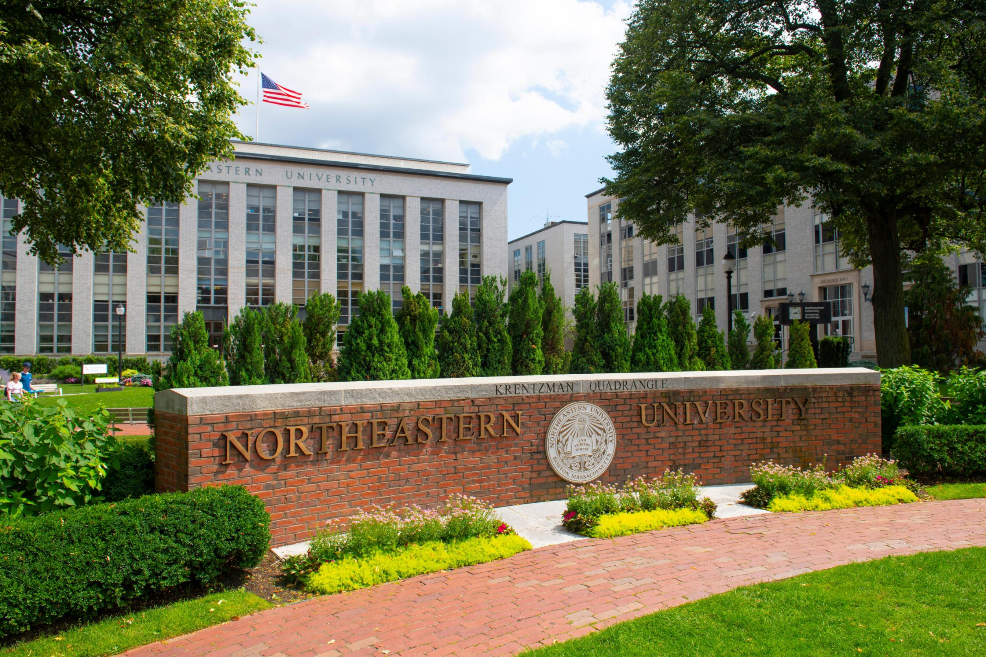

Northeastern university
Located in Boston
High housing price
Big city
Small campus
Terrible dining hall
Expensive living cost

Slide 3

Research Question
How would Chinese students in Northeastern University fit in university life?
How should Chinese students search for their university life?
How could Chinese students live in America in a more comfortable way?

Slide 4
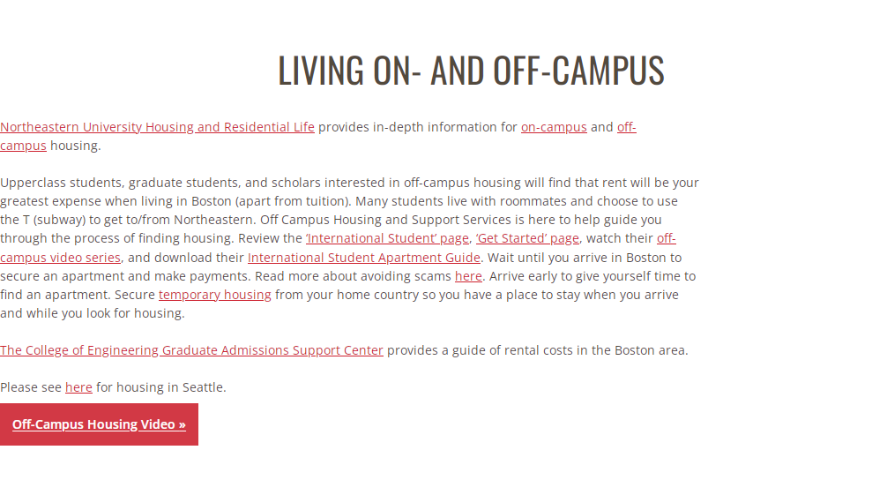
Background Research
https://international.northeastern.edu/ogs/student-support/resources/housing/

Slide 5
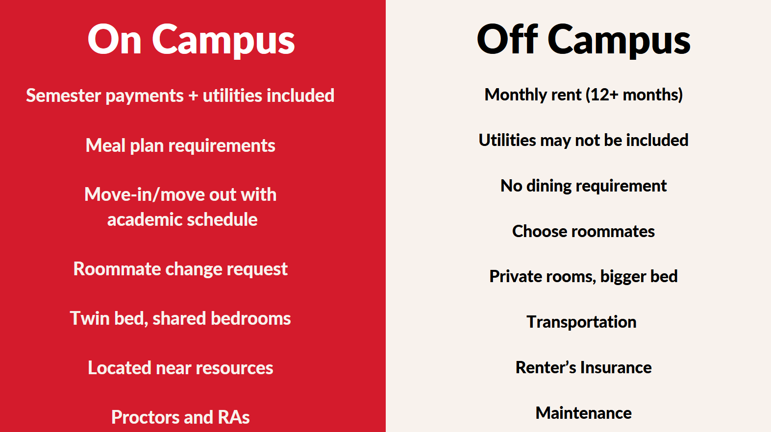

Slide 6
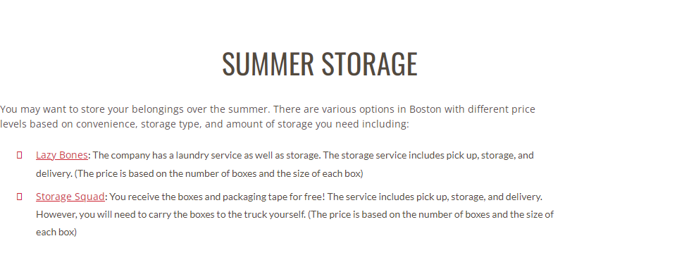
Research
https://international.northeastern.edu/ogs/student-support/resources/housing/
Lazy Bones:
Laundry provided
Various services
Storage Squad:
Cheaper Prices
Fewer services

Slide 7
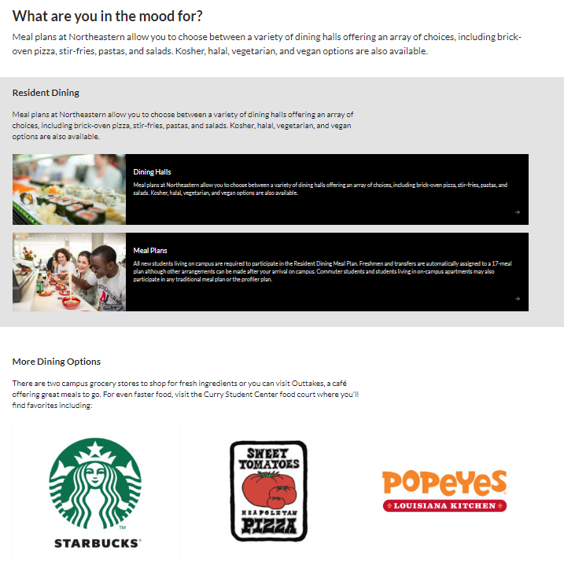
Research & Summary
Meal plans selections on-campus
More Dining Options off-campus
https://admissions.northeastern.edu
/student-life/dining-on-campus/

Slide 8
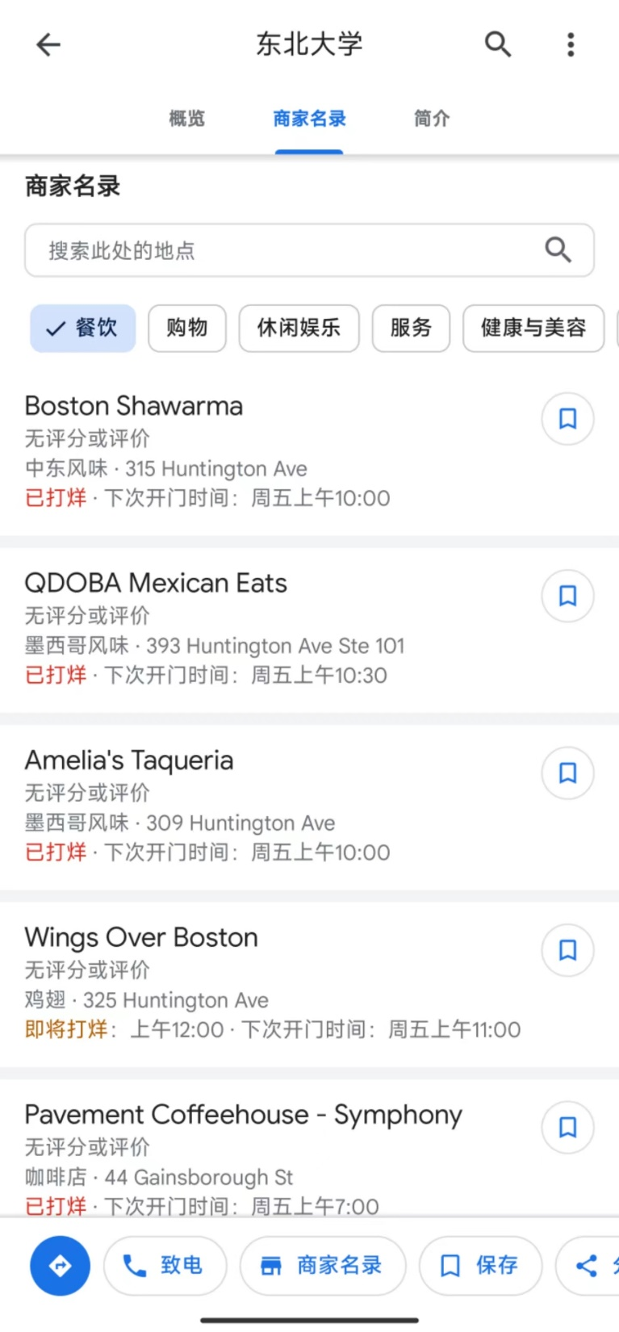
Research
Google Map
Food
Shopping
Entertainment
Service
Living

Slide 9
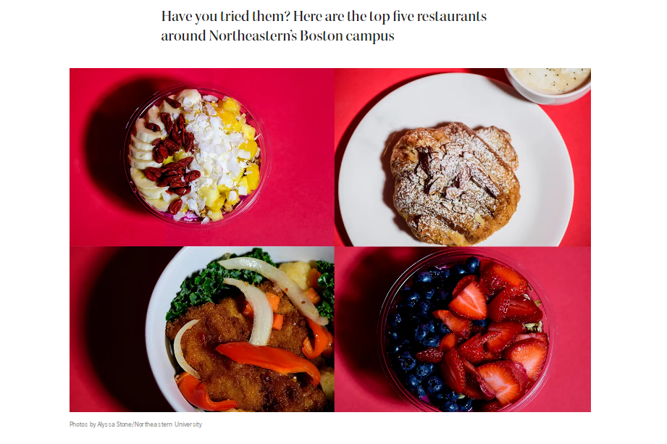
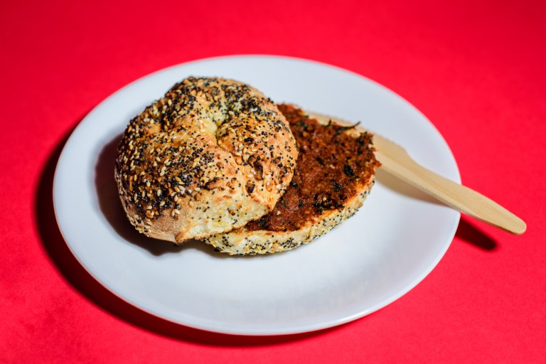
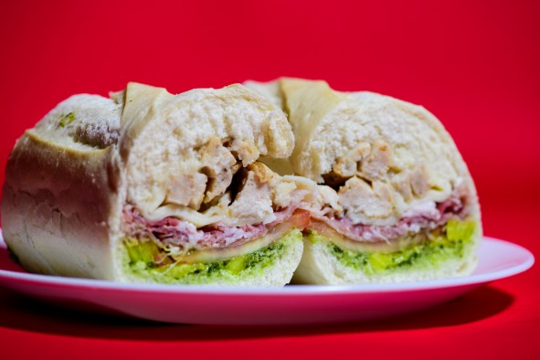
Background Research
TOP 5 restaurants around NU
https://news.northeastern.edu/2022/10/12/best-restaurants-near-boston-campus/

Slide 10
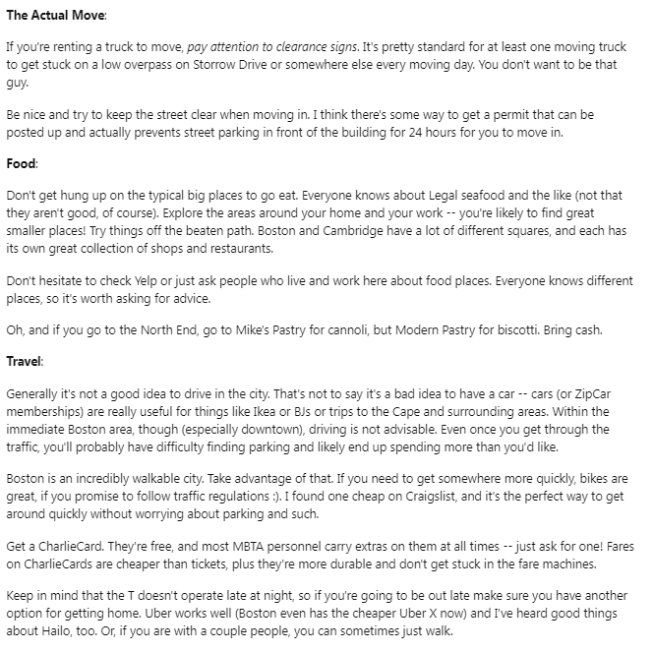
Research
Reddit Website
More Details
Accessible to all people
Easy to enter
Information is unauthentic
https://www.reddit.com/r/boston/comments/1estam/moving_to_boston_what_do_i_need_to_know/

Slide 11
Conclusion
In conclusion, Chinese students at Northeastern University can prepare for a fulfilling university life by understanding the available housing options, exploring diverse dining choices, utilizing storage solutions, familiarizing themselves with local resources, and considering extra expenses and healthcare needs. By planning ahead and seeking relevant information, Chinese students can enhance their overall experience at Northeastern University and live comfortably in America.

Slide 12
Problems in the Project/Suggestions for Future
Unavailability of field investigation
Lack of understanding of US social media and forums
Hard to distinguish whether information on the Internet is true or false
Different eating habits between Chinese and Americans

Slide 13
Thanks for listening

